Slide 1










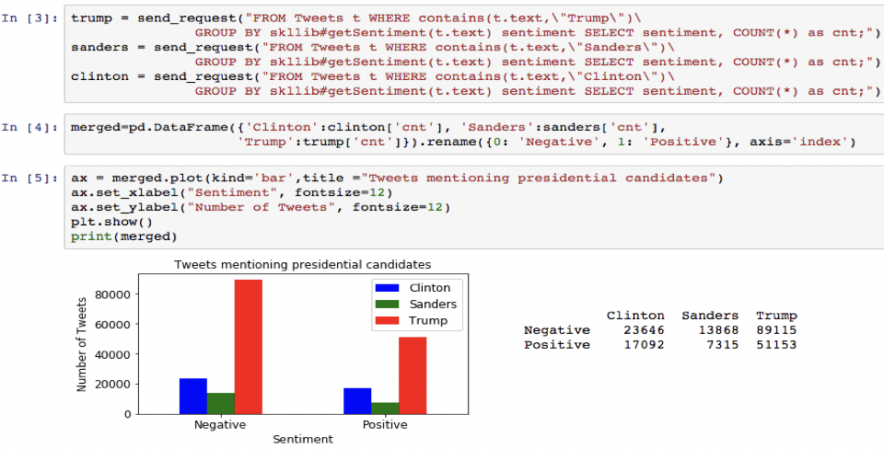





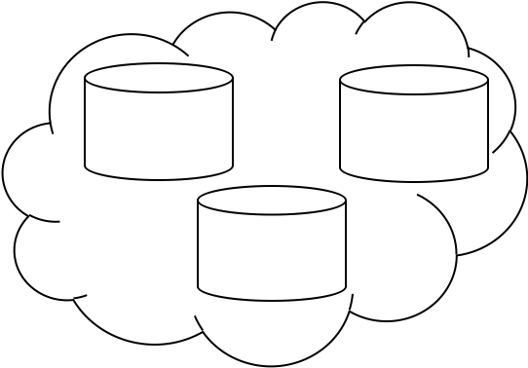
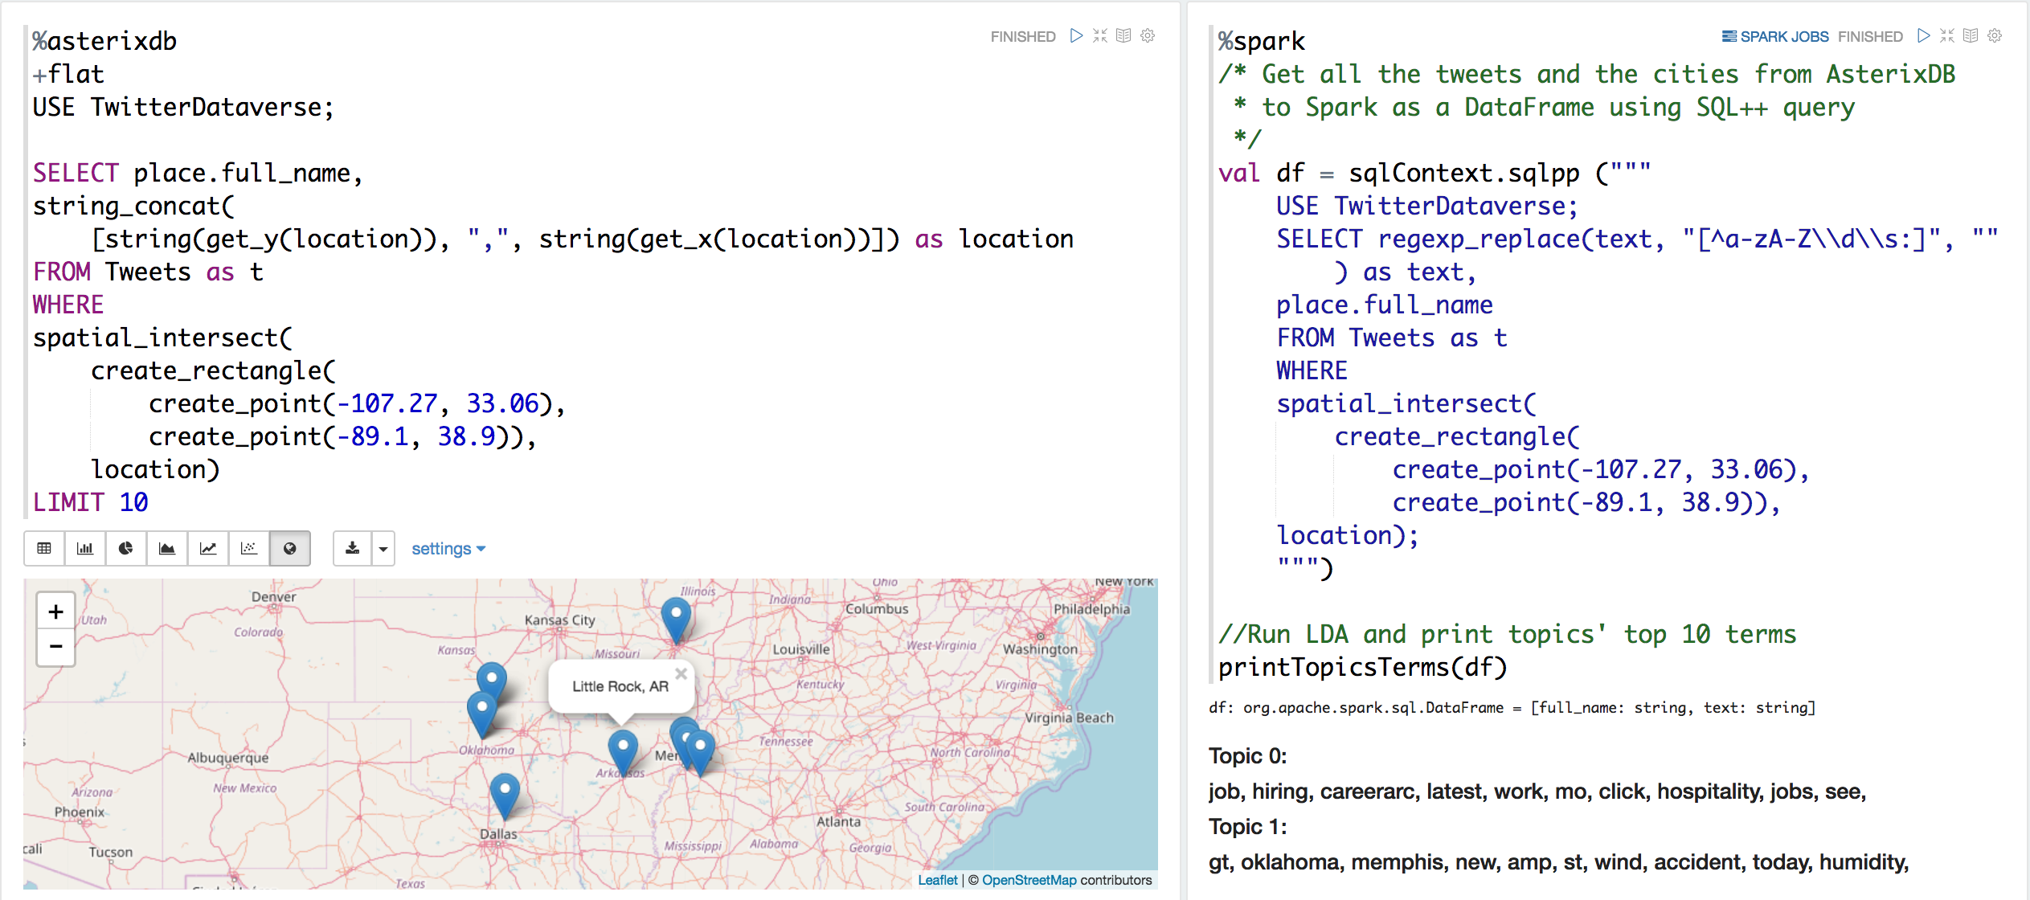
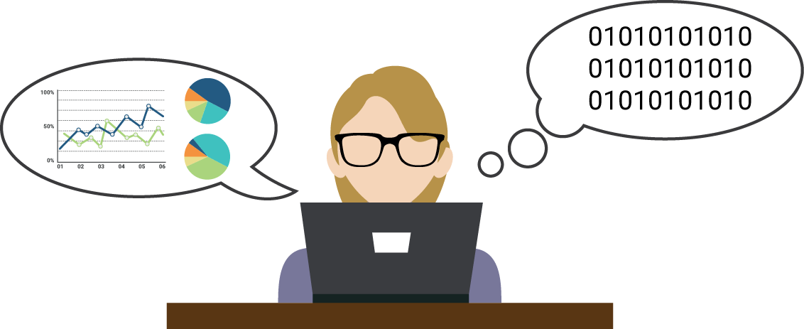








End-to-End Machine Learning with Apache AsterixDB
Wail Alkowaileet∗, Sattam Alsubaiee†, Michael J. Carey∗, Chen Li∗, Heri Ramampiaro‡, Phanwadee Sinthong∗ and Xikui Wang∗
∗University of California Irvine Email: w.alkowaileet, mjcarey, chenli, psinthon, xikuiw@ics.uci.edu
‡Norwegian University of Science and Technology Email: heri@ntnu.no †Center for Complex Engineering Systems at KACST and MIT
Email: ssubaiee@kacst.edu.sa
Challenges
Notebook Integration
Datasources
High Speed Datasources
Analysts w/o computer expertise
Sentiment analysis and visualization with Jupyter Notebook and Scikit-Learn.
Big Data Analytics
Expensive Analytics
Distributed Environment
Existing Solutions
Geospatial data visualization and topic analysis with Apache Zeppelin and Spark.
Our Approach
Datasources
Training Data
Data Analysts
Machine Learning Libraries
Experiments
...
Query
Sentiment analysis of incoming Tweets using built-in Twitter adapter and SNLP.
Feed
{..., text: “I’m upset.”, ...}
Model Specs
Ingestion Pipeline
Query Evaluation Pipeline
...
Storage
...
{..., text: “I’m upset.”,
sentiment: “Negative”, …}
Raw Tweets
AsterixDB
Data Feeds – Extensible data ingestion for different active data sources.
UDF framework – Scalable machine learning algorithm evaluation.
SQL++ – SQL-like query language for semi-structured data.
Machine learning libraries – Allowing users to utilize machine learning algorithms for complex data analytics.
Notebook Integration – Enabling Data Analysts to work with Big Data interactively.
Scale-out experiment with 2, 4, 6, 8 nodes processing 160k, 320k, 480k, and 640k Tweets respectively.
Speed-up experiment with 400,000 Tweets on 2, 4, 6, 8 nodes.
References
[1] S. Alsubaiee et al., “AsterixDB: A scalable, open source BDMS,” Proceedings of the VLDB Endowment, vol. 7, no. 14, pp. 1905–1916, 2014.
[2]K. W. Ong, Y. Papakonstantinou, and R. Vernoux, “The SQL++ query language: Configurable, unifying and semi-structured,” arXiv preprint arXiv:1405.3631, 2014.
[3] R. Grover and M. J. Carey, “Data ingestion in AsterixDB.” in EDBT, 2015, pp. 605–616.
[4] W. Y. Alkowaileet, S. Alsubaiee, M. J. Carey, T. Westmann, and Y. Bu, “Large-scale complex analytics on semi-structured datasets using AsterixDB and Spark,” Proceedings of the VLDB Endowment, vol. 9, no. 13, pp. 1585–1588, 2016.
An Example with WEKA
Configuring a UDF to be used in data ingestion pipelines and queries via a simple XML spec.
Required configuration info:
Function name
classifyTweetSentiment
classifySpamTweet
Argument data types
Tweet
Algorithm
Random Forest
Model files
Models for sentiment analysis.
Models for spam tweets detection.
The work reported in this paper was supported in part by NSF CNS award 1305430.

